Slide 1








Andover High School Professional Development Day:
Gale Digital Curriculum
Julie Pepera
Gale Customer Education Specialist
Julie.pepera@cengage.com
Notes:
Welcome to Gale Cengage Learning. I’m (name).
Picture yourself as a student. You have an assignment and a laptop. You want to get credible information without a lot of hassle. And you want content tied to the way you learn best.
But all that comes later. Right now, the question is

Slide 2

Agenda for Today
Introductions
What are in the Gale Resources
Tools for Differentiated Learning
Bookmarking
Intro to the Curriculum Tool
How to add resources
PD Exercise
Survey
Notes:
Gale Business Insights Global is the first learning resource designed to give students a true competitive advantage I the international marketplace.
Deep business intelligence powered by statistical data lets students spend less time researching for content and more time connecting their discoveries to practical applications.
And what makes this resource work so efficiently? Quite simply, it’s designed around student behaviors, study habits and expectations.
This chart, for instance, shows what a student will find when searching for Chile’s Gross Domestic Product over a period of decades. And with a few simple steps, you can: add comparative data from Argentina; get the details in table form; then compare the two countries’ unemployment rate over the same period.
That’s the kind of speed and context that users demand. And that’s just a small sample of what this product delivers.

Slide 3
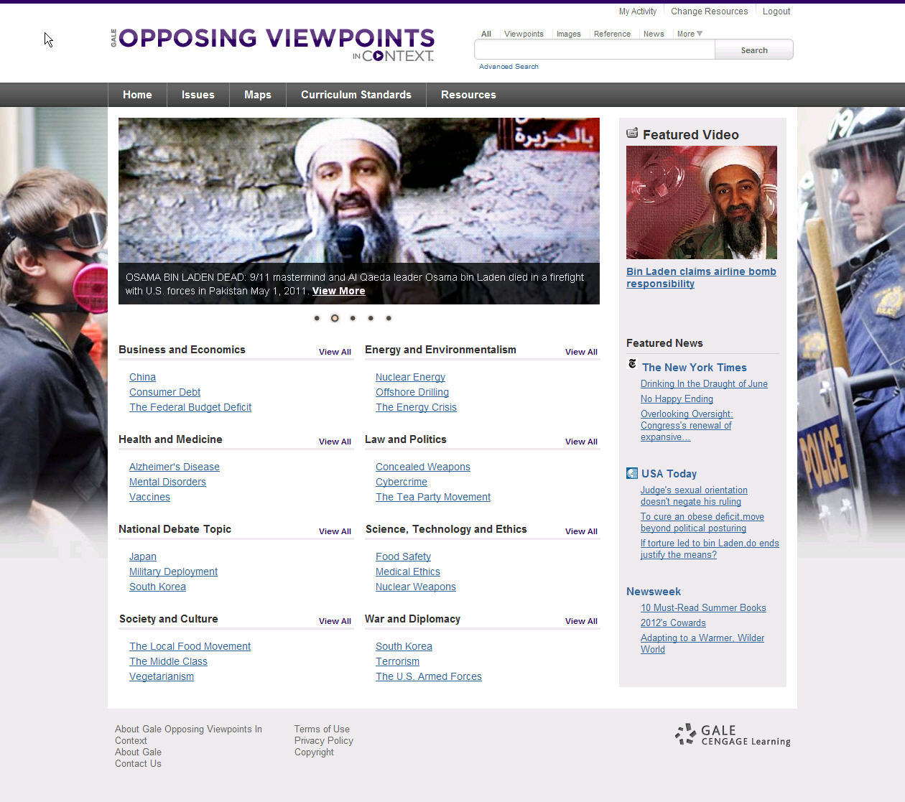
Objectives
Understand what the Gale Resources are and how they can be best used in the classroom
Understand the new digital curriculum tool and how to add resources to it to tailor it to your needs
Others?
Notes:
Gale Business Insights Global is the first learning resource designed to give students a true competitive advantage I the international marketplace.
Deep business intelligence powered by statistical data lets students spend less time researching for content and more time connecting their discoveries to practical applications.
And what makes this resource work so efficiently? Quite simply, it’s designed around student behaviors, study habits and expectations.
This chart, for instance, shows what a student will find when searching for Chile’s Gross Domestic Product over a period of decades. And with a few simple steps, you can: add comparative data from Argentina; get the details in table form; then compare the two countries’ unemployment rate over the same period.
That’s the kind of speed and context that users demand. And that’s just a small sample of what this product delivers.

Slide 4
Links
For Teachers
http://galedc.com/admin
For Students
Economics: http://galedc.com/site/andover/andover_eco.php
Health: http://galedc.com/site/andover/andover_health.php
AP Gov: http://galedc.com/site/andover/andover_apgov.php
Mr. Sugg
Username: sugg
Password: password
Ms. Cervi
Username: erin_cervi
Password: password
Ms. Hiatt
Username: lisahiatt
Password: password
Notes:
This engaging suite is made up of eight learning resources targeting coverage of core subjects like science, history, biography and current events.
A fresh, vivid approach attracts today’s media-driven student, offering an array of research tools geared to the way teachers teach and students learn. The more engaging the technology, the more attention it gets from the student.

Slide 5
Demonstration
As a Bullet Point
The Convention
http://www.archives.gov/exhibits/charters/constitution.html
In the Side Menu
Periodical
Newsweek
http://go.galegroup.com/ps/i.do?id=GALE|0AYS&v=2.1&u=lom_ando&it=aboutJournal&p=GPS&sw=w

Slide 6
Demonstration
As a Lesson Plan (Hidden from the Students)
Under a subTopic
Scavenger Hunt Exercise

